Slide 1
Feature Extraction and Selection
CIS662, Sep. 13, 2023

Slide 2
Class Exercise
Learning task: to predict someone’s final future GPA after 2 years
Inputs: all possible information from a graduate student’s application
Questions:
What attributes are useful for accurate prediction?
Which specific arithmetic combinations of attributes are more useful than the raw attributes themselves?
How would we discover these?

Slide 3
What are “Features” (in the ML context)
Attributes or their combinations that are most useful for the ML task, i.e., those which make it easier for learning to be accomplished.
Three kinds of features:
1. Attributes
2. Linear combinations of attributes
3. Nonlinear combinations of attributes

Slide 4
Example of a well-known feature
APGAR score: summarizing Appearance, Pulse, Grimace, Activity, Respiration for a newborn
 | Score of 0 | Score of 1 | Score of 2 | Component of backronym
Skin color | blue or pale all over | blue at extremities, body pink (acrocyanosis) | no cyanosis body and extremities pink | Appearance
Pulse rate | absent | < 100 beats per minute | ≥ 100 beats per minute | Pulse
Reflex irritability grimace | no response to stimulation | grimace on suction or aggressive stimulation | cry on stimulation | Grimace
Muscle Tone | none | some flexion | flexed arms and legs that resist extension | Activity
Respiratory effort | absent | weak, irregular, gasping | strong, robust cry | Respiration

Slide 5
Examples of domain-specific features
Natural language processing: bag of words, n-grams
Speech processing: phonemes, syllables
Image processing: straight line segments, curves, circle, other shape primitives
Medical diagnosis: clusters of related symptoms
Some ML models such as neural networks simultaneously perform feature extraction while solving a supervised learning problem.

Slide 6
Attributes may be strongly correlated!
Example: a student’s grades in Calculus 1 and Calculus 2 courses—usually (but not always) they are both low or both high.
So what?
A prediction may strongly depend on these attributes, but knowing either one is sufficient, the second one does not provide additional information for the prediction task.

Slide 7
Attribute Selection
Given: a labeled data set with many attributes, determine which attributes are (a) irrelevant; (b) useful; (c) most useful for the prediction task.
Best scenario: decide before applying an ML algorithm.
Usual scenario: learn model parameters first, and then perform post-hoc analysis.

Slide 8
“Early” decisions about attribute selection
Prior knowledge is helpful: delete attributes known to be merely identifiers of individual data (e.g., name, SUID, address, …)—doing this will prevent the possibility of spurious inferences.
Magnitude of correlation of attribute with the data label (or quantity to be predicted): if correlation is highly positive or negative, we know the attribute is more useful for prediction.
Correlation between attributes: if two attributes are strongly correlated (positively or negatively), one can be omitted.

Slide 9
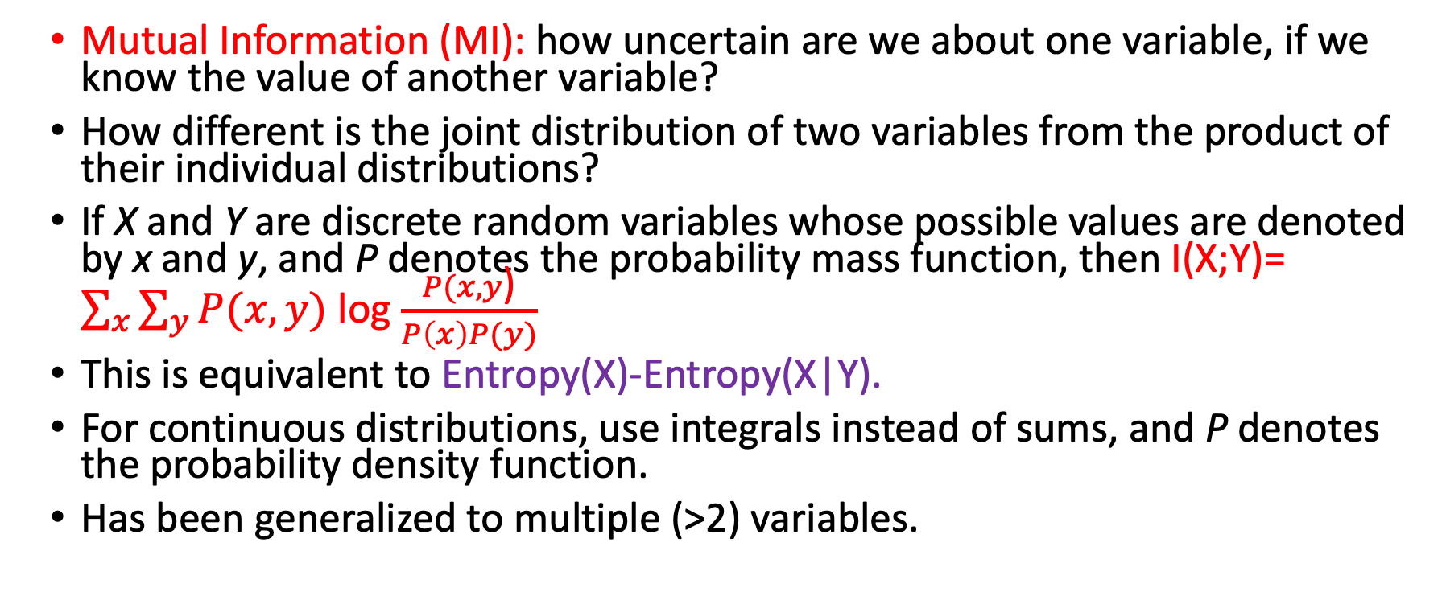
Can we do better than linear correlation?
Mutual Information (MI): how uncertain are we about one variable, if we know the value of another variable?
How different is the joint distribution of two variables from the product of their individual distributions?
If X and Y are discrete random variables whose possible values are denoted by x and y, and P denotes the probability mass function, then I(X;Y)= $\sum_{x}{\sum_{y}{P(x,y)}}$ log $\frac{P(x,y\text{)}}{P\left(x\right)P(y)}$
This is equivalent to Entropy(X)-Entropy(X|Y).
For continuous distributions, use integrals instead of sums, and P denotes the probability density function.
Has been generalized to multiple (>2) variables.

Slide 10
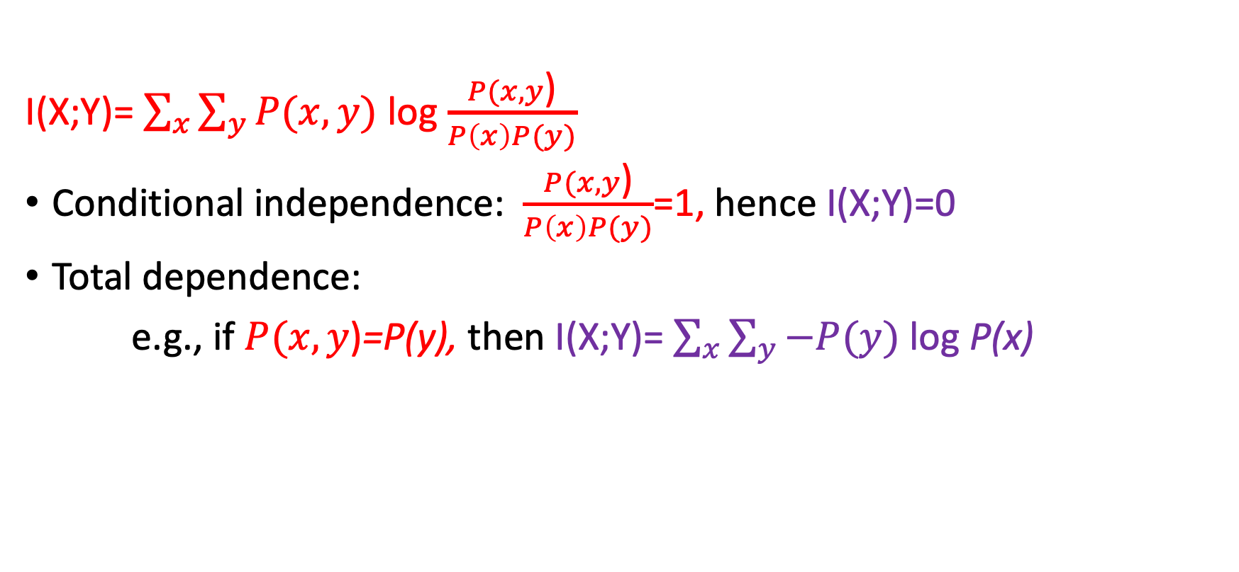
Extreme cases for Mutual Information
I(X;Y)= $\sum_{x}{\sum_{y}{P(x,y)}}$ log $\frac{P(x,y\text{)}}{P\left(x\right)P(y)}$
Conditional independence: $\frac{P(x,y\text{)}}{P\left(x\right)P(y)}$=1, hence I(X;Y)=0
Total dependence:
e.g., if $P(x,y\text{)}$=P(y), then I(X;Y)= $\sum_{x}{\sum_{y}{−P(y)}}$ log P(x)

Slide 11
Using Mutual Information for Feature Selection
How useful is an attribute X for predicting Y?
= How large is I(Y;X)?
Which subset of k attributes of input data are most useful for predicting Y?
= find the subset of attributes A with the highest I(Y; A).
How redundant is variable X, given variable Y?
= How large is I(X;Y)/(Entropy(X) + Entropy(Y)) ?

Slide 12
Linear Combinations of Attributes
Both correlation and mutual information focus on the given individual attributes by themselves.
What if we would like to find the most useful features that are linear combinations of attributes?
This is achieved by Principal Component Analysis.

Slide 13
Principal Component Analysis (PCA)
Given: data consisting of many attributes (columns in a table).
Find:
Among all possible (infinitely many) linear combinations of attributes, which one is the most useful?
Given k>0, mong all possible linear combinations of attributes which k linear combinations are (together) the most useful?
Alternate framing:
Which linear combinations capture the most information available in the given data?

Slide 14
Principal Component Analysis
Subtract the mean from every point.
Calculate the covariance matrix.
Compute its Eigenvectors and Eigenvalues.
Normalize the Eigenvectors to have unit length.
Measure the relative importance of each Eigenvector as the ratio of its Eigenvalue to the sum of all Eigenvalues.
Select the k most important Eigenvectors.

Slide 15
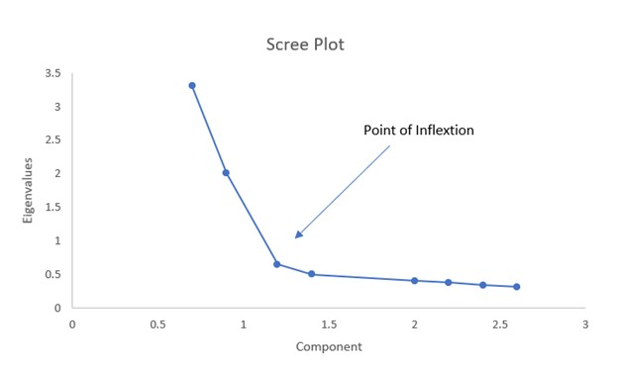
How many (k) Eigenvectors are enough?

Slide 16
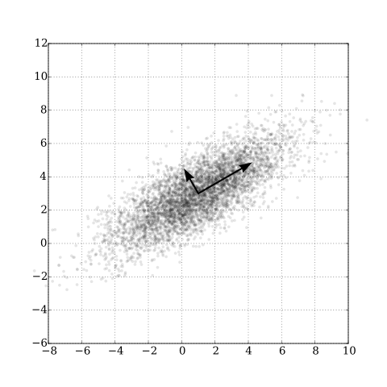
Finding Eigenvectors Iterative algorithms have been developed, but currently the most efficient approach is “Singular Value Decomposition”

Slide 17
Using Eigenvectors to identify Principal Components
Given: matrix A
1. Find vector X and value c such that AX=cX
--X is an Eigenvector and c is the corresponding Eigenvalue.
2. Find a set of mutually orthogonal Eigenvectors S (scaled to have unit length) and their corresponding Eigenvalues.
3. Find the set of unit length mutually orthogonal Eigenvectors sorted in the order of decreasing Eigenvalue magnitudes.
4. Select the first k among the set of unit length mutually orthogonal Eigenvectors sorted in the order of decreasing Eigenvalue magnitudes.

Slide 18
Geometric Perspective
Goal: to project d-dimensional data into k (<d) dimensions.
Information loss can occur when we project data into a low dimensional space; the best projections are those that minimize such information loss.
Merely ignoring d-k dimensions may result in too much information loss!
We can minimize information loss by projecting into a space whose basis vectors are the Eigenvectors corresponding to the largest Eigenvalues.
The amount of information loss can be assessed as proportional to the sum of the magnitudes of the remaining (unchosen) Eigenvalues.
PCA “rotates” the data space to align with the Eigenvectors that capture most of the variance in the given data.

Slide 19
Singular Value Decomposition (SVD)
Express a given matrix X (representing all available data) as the product of three other matrices, i.e., X=USW^{T}, where:
S is a rectangular diagonal matrix,
the columns of U are orthogonal unit vectors, and
W is a square matrix whose columns are orthogonal unit vectors.
Then the vectors of W are the Eigenvectors of X^{T}X, and the elements of S are the square roots of the Eigenvalues of X^{T}X.
Efficient algorithms exist for SVD computations, hence for PCA.

Slide 20
Nonlinear Attribute Combinations
What if we need to “discover” nonlinear attribute combinations that are most useful for a given problem?
Any not-too-lossy data compression technique can be thought of as accomplishing this goal.
Possible, but much more computation is needed.
Examples: (discrete) Fourier transform, Cosine transform, kernel PCA

Slide 21
Kernel PCA
Kernels: provide functions that map to higher-dimensional spaces within which data from different classes is linearly separable.
Clever tricks are used to facilitate fast computation, avoiding explicit representation, instead working with the dot products of transformed vectors.
Examples: Polynomial kernels, Gaussian kernels

Slide 22
Factor analysis
Methods describing observed data attributes as linear combinations of unobserved latent variables (plus some error).
Exploratory Factor Analysis: to identify relationships between observed attributes. If data is normally distributed, a Maximum Likelihood approach is used; else Principal Axis Factoring (similar to PCA).

Slide 23
Other PCA variations
Independent Component Analysis (ICA): used to separate signals into independent non-Gaussian components, i.e., recovering pieces from a combination.
Canonical Correlation Analysis (CCA): transforms two sets of variables into projections in which their correlation is maximized.

Slide 24
Feature selection after Machine Learning
When fast ML algorithms are available, and if it is not possible to identify features beforehand, we can analyze the results of ML to identify the most useful attributes or features.
After such identification, the ML model architecture can be simplified.
The simpler ML model can be iteratively retrained to improve its performance.
Advantage: we obtain a good empirical evaluation of which attributes are useful.
Drawback: too much effort may be spent in training and retraining the models.

Slide 25
Iterative “Leave-one-out” approach —assuming low correlation between attributes
Train ML model using all attributes; let its loss function value be E.
For each attribute a, do:
Delete a from the trained model;
Retrain the model;
Let the loss function of the resulting model be E_{a}
Evaluate the importance of a to be (E-E_{a}).
Select the attributes that maximize (E-E_{a}).
Build a new model with the selected attributes.
Train the new model.

Slide 26
Iterative “Add-one-in” approach —not assuming low correlation
Train ML model using all attributes; let its loss function value be E;
While the number of selected attributes<k, do:
For each remaining (unselected) attribute a, do:
Delete a from the trained model;
Retrain the model;
Let the loss function of the resulting model be E_{a}
Evaluate the importance of a to be (E-E_{a});
Select attribute a* that maximizes (E-E_{a});
Add a* to the list of selected attributes;
Delete a* from the trained model, retrain, and let its loss function value be E;
3. Build a new model with the selected attributes.
4. Train the new model.

